Slide 1
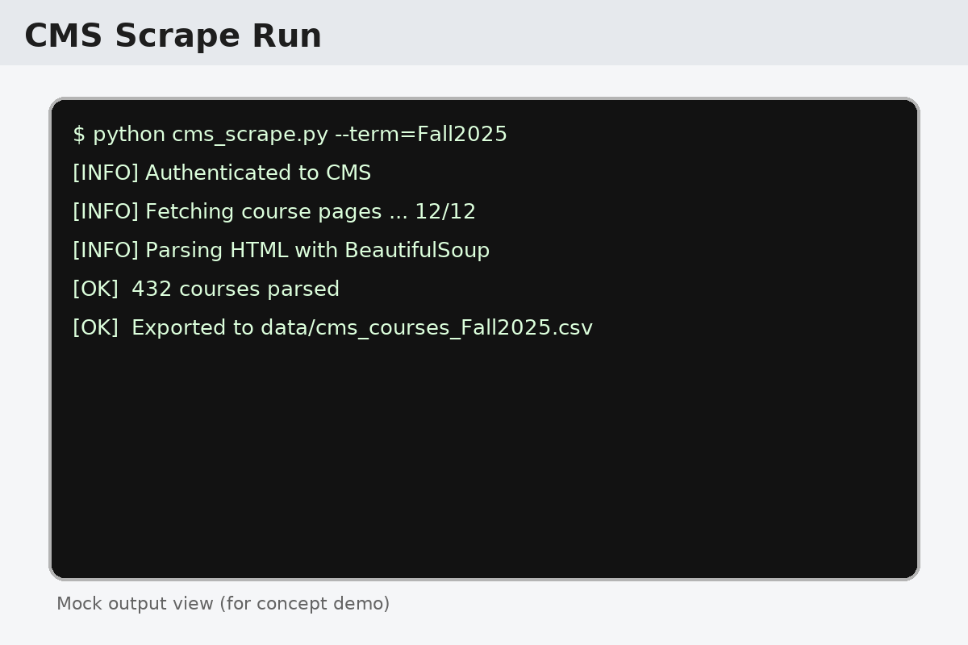
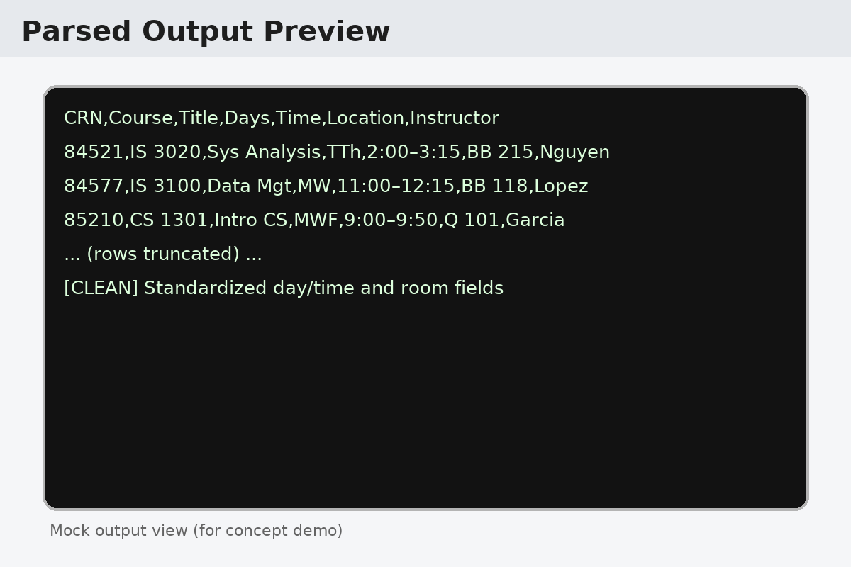
KSU CMS Scraper
“Automatically pulls course info from KSU CMS into structured data.”
Team: Tomiwa Aroyewun
  Course: IS Project — KSU
  GitHub: https://github.com/Tomzy50/pythonteachingcode/blob/master/2%20ksu%20scrape/cms_scrape.py
Key Capabilities
  • Automates pulling course data from KSU CMS pages
  • Parses & cleans HTML into structured CSV/JSON
  • Searchable outputs for planning and analysis
  • Built with Python (requests, BeautifulSoup); extensible scheduler
Contact: Tomiwa Aroyewun • Deliverable: 1-slide intro • © 2025

